Slide 1
CCE 313 Computer Networks CCE 314 Computer Networks Sessional
Prof. Dr. Md. Samsuzzaman
Sarna Majumder, Associate Professor

Slide 2
1-1 A BRIEF HISTORY
A network is a group of connected, communicating devices such as computers and printers. An internet is two or more networks that can communicate with each other. The most notable internet is called the internet, composed of hundreds of thousands of interconnected networks. Private individuals as well as various organizations such as government agencies, schools, research facilities, corporations, and libraries in more than 100 countries use the Internet.

Slide 3
Internet Evoluation
ARPANET
Birth of the Internet
TCP/IP
MILNET
CSNET
NSFNET
ANSNET
The Internet Today
World Wide Web
Growth of the Internet

Slide 4
Topics Discussed in the Section
Protocols
Standards
Standards are developed through the cooperation of standards creation committees, forums, and government regulatory agencies.
RFCs can be found at http://www.rfc-editor.org.
A Request for Comments (RFC) is a formal document from the Internet Engineering Task Force ( IETF ) that is the result of committee drafting and subsequent review by interested parties. Some RFCs are informational in nature. Of those that are intended to become Internet standards, the final version of the RFC becomes the standard and no further comments or changes are permitted. Change can occur, however, through subsequent RFCs that supersede or elaborate on all or parts of previous RFCs.

Slide 5
1-5 INTERNET ADMINISTRATION
The Internet, with its roots primarily in the research domain, has evolved and gained a broader user base with significant commercial activity. Various groups that coordinate Internet issues have guided this growth and development.
Internet Society (ISOC)
Internet Architecture Board (IAB)
Internet Research Task Force (IRTF)
Internet Assigned Number Authority (IANA)
Internet Corporation for Names and Numbers (ICANN)
Network Information Center (NIC)

Slide 6
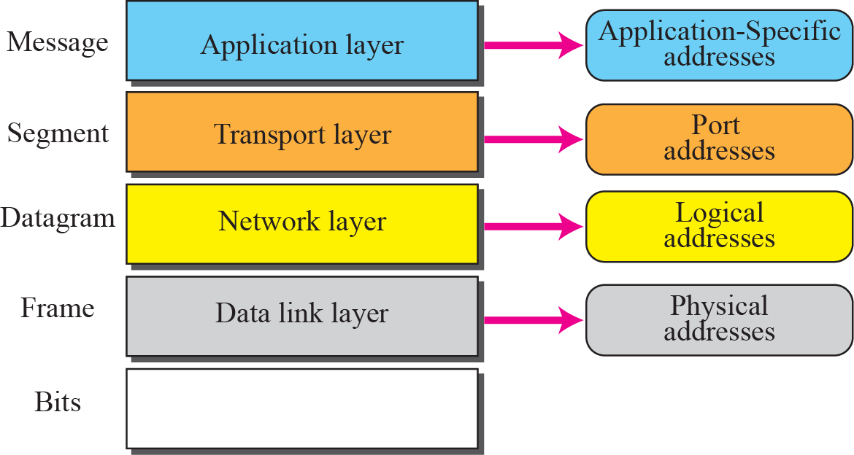
2-4 ADDRESSING
Four levels of addresses are used in an internet employing the TCP/IP protocols: physical address, logical address, port address, and application-specific address. Each address is related to a one layer in the TCP/IP architecture, as shown in Figure 2.15.
Physical Addresses
Logical Addresses
Port Addresses
Application-Specific Addresses

Slide 7
Figure 2.15 Addresses in the TCP/IP protocol suite

Slide 8
The physical addresses will change from hop to hop, but the logical addresses remain the same.
The physical addresses change from hop to hop, but the logical and port addresses usually remain the same.

Slide 9
Example 2.4
As we will see in Chapter 3, most local area networks use a 48-bit (6-byte) physical address written as 12 hexadecimal digits; every byte (2 hexadecimal digits) is separated by a colon, as shown below:
07:01:02:01:2C:4B
A 6-byte (12 hexadecimal digits) physical address

Slide 10
Example 2.7
As we will see in future chapters, a port address is a 16-bit address represented by one decimal number as shown.
753
A 16-bit port address represented as one single number
A port number can range from 0-65535, but port numbers between 0-1023 are termed as well known ports because most of the popular services are under these range only such as 21 for FTP,80 for HTTP, 443 for HTTPS, 23 for TELNET and 22 for SSH

Slide 11

Chapter 3
Underlying Technology
Copyright © The McGraw-Hill Companies, Inc. Permission required for reproduction or display.

Slide 12
3-1 WIRED LOCAL AREA NETWORKS
A local area network (LAN) is a computer network that is designed for a limited geographic area such as a building or a campus. Although a LAN can be used as an isolated network to connect computers in an organization for the sole purpose of sharing resources, most LANs today are also linked to a wide area network (WAN) or the Internet.
The LAN market has seen several technologies such as Ethernet, token ring, token bus, FDDI, and ATM LAN, but Ethernet is by far the dominant technology.

Slide 13
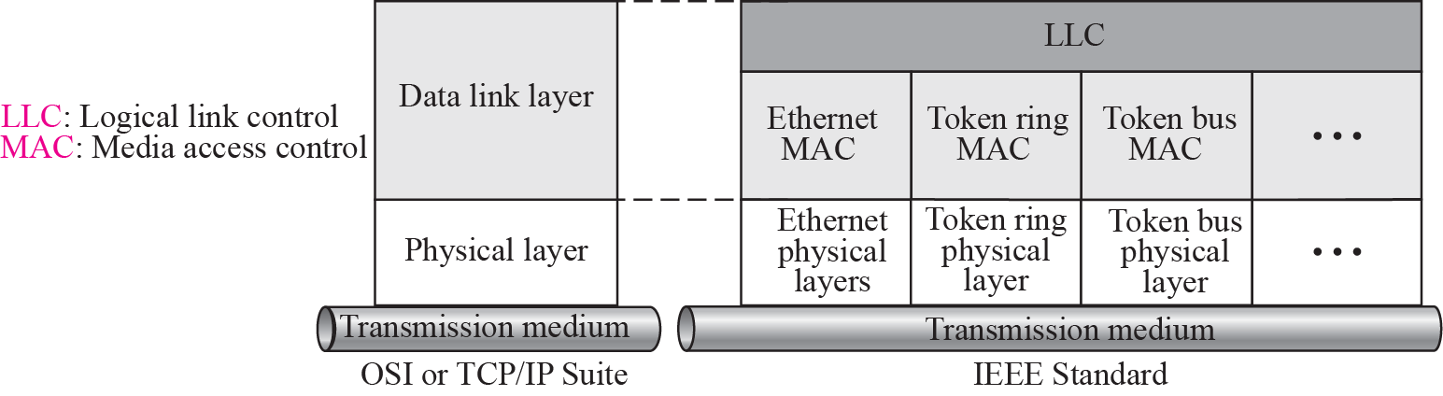
Figure 3.1 IEEE standard for LANs

Slide 14
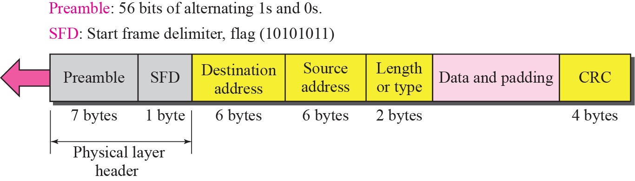
Figure 3.2 Ethernet Frame

Slide 15
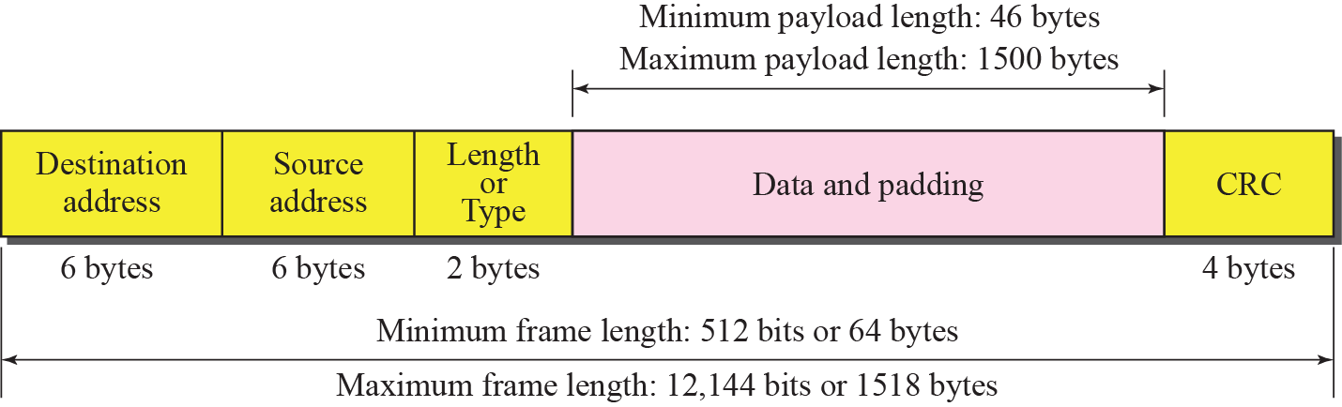
Figure 3.3 Maximum and minimum lengths

Slide 16
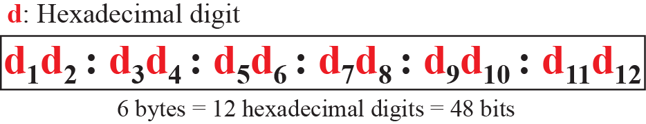
Figure 3.4 Ethernet address in hexadecimal notation

Slide 17
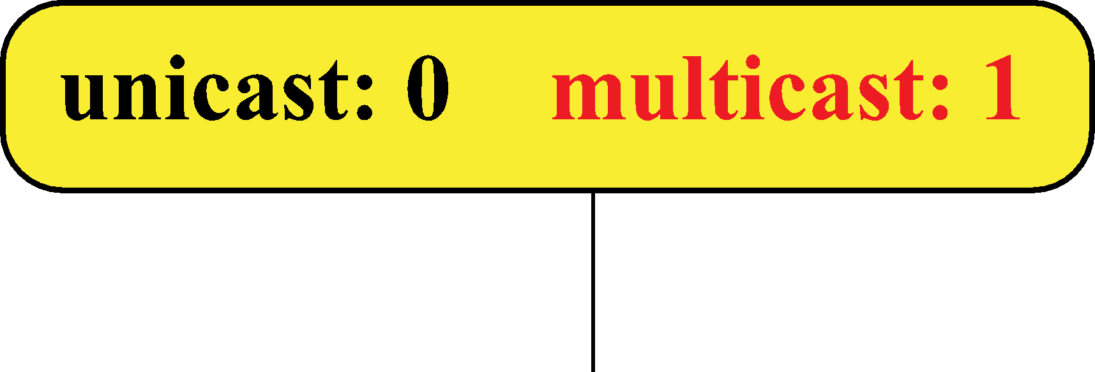
Figure 3.5 Unicast and multicast addresses
The broadcast destination address is a special case of the multicast address in which all bits are 1s.
The least significant bit of the first byte defines the type of address.
If the bit is 0, the address is unicast; otherwise, it is multicast.

Slide 18
Example 3.1
Define the type of the following destination addresses:
a. 4A:30:10:21:10:1A 1010
b. 47:20:1B:2E:08:EE 0100 0111
c. FF:FF:FF:FF:FF:FF
Solution
To find the type of the address, we need to look at the second
hexadecimal digit from the left. If it is even, the address is unicast. If it is odd, the address is multicast. If all digits are F’s, the address is broadcast. Therefore, we have the following:
a. This is a unicast address because A in binary is 1010 (even).
b. This is a multicast address because 7 in binary is 0111 (odd).
c. This is a broadcast address because all digits are F’s.

Slide 19
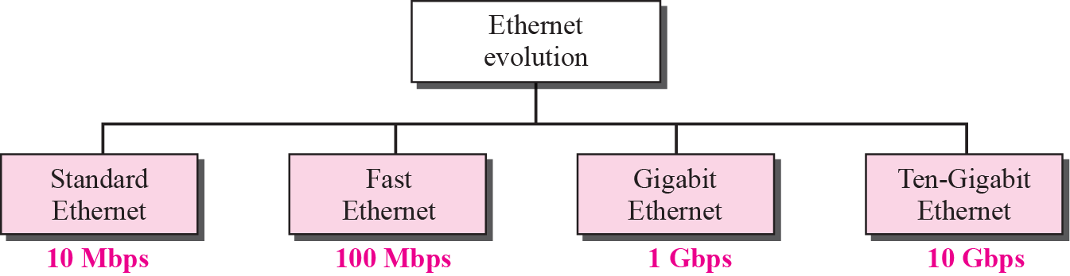
Figure 3.6 Ethernet evolution through four generations

Slide 20
3-3 POINT-TO-POINT WANS
A second type of network we encounter in the Internet is the point-to-point wide area network. A point-to-point WAN connects two remote devices using a line available from a public network such as a telephone network. We discuss traditional modem technology, DSL line, cable modem, T-lines, and SONET.
T Lines
SONET
PPP
PPPoE (Point-to-Point Protocol over Ethernet)
56K Modems
DSL Technology
Cable Modem

Slide 21
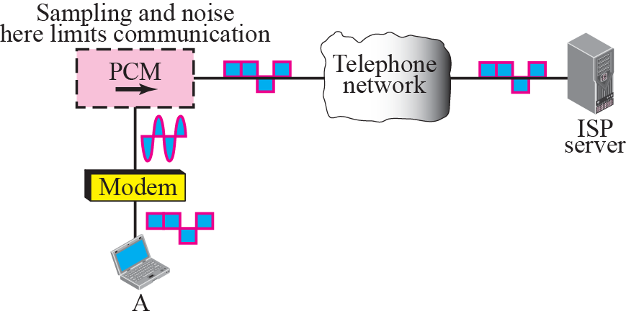
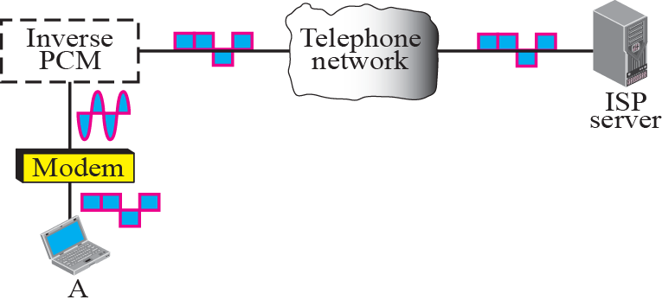
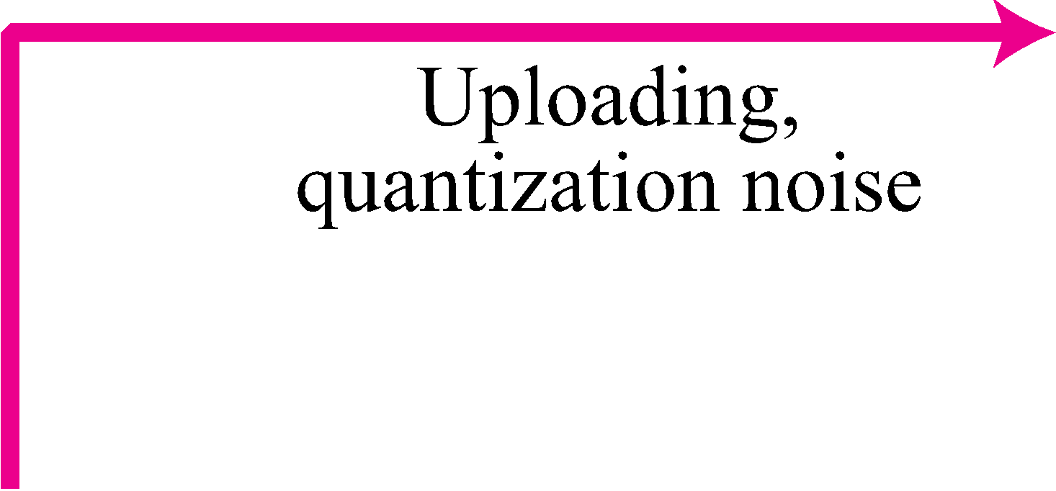
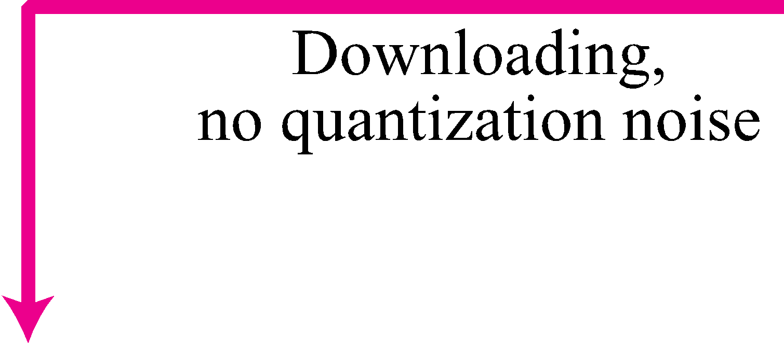
Figure 3.26 56K modem

Slide 22

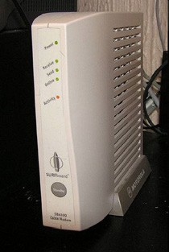

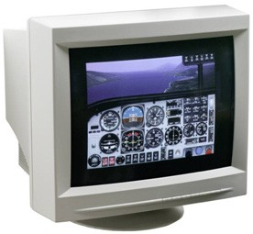
DSL
q Digital Subscriber Line (DSL)
q Can transmit very high data rates on phone wire using special equipment at the phone company allowing higher frequency signals
High-Speed ISP’s
Network Network
Home PC DSL ^{DSLAM} Phone
Modem Company
q DSL Access Multiplexer (DSLAM)
q 100 kbps - 100 Mbps
_{Faculty CSE PSTUCCE 313}
1-29

Slide 23
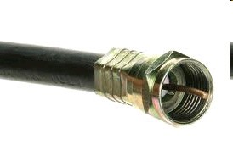

Cable
q Cable companies have a very-high speed medium (for video transmission)
q Phone wire = 4kHz for voice Video Cable = 500 MHz for video One TV Channel = 6 MHz
q 30 Mbps down/1 Mbps up
q Fiber in the main line + Coax in tributaries ^{Cable}
_{⇒ Hybrid Fiber Coax (HFC)} ^{Modem}
Home 1 Home 2 Home 3 Home 4
Cable
_{Faculty CSE PSTUCCE 313}
Company
Fiber
1-30

Slide 24
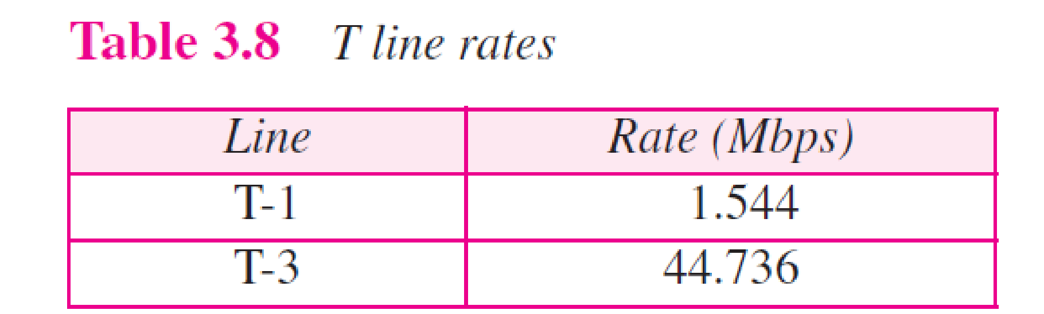

Slide 25
Fiber-To-The-Home (FTTH)
Optical
Internet/Ethernet ^{Network}
Leased Line T1/E1 _{Optical}
^{Frame/Cell Relay} _{Line} ^{ONU}
^{Telephone} Terminal
Interactive Video
Splitter
q 100+ Mbps per home. Multiple services.
q No electronic components in the distribution system
⇒ Passive ⇒ Reliable
q Passive Optical Network (PON)
_{Faculty CSE PSTUCCE 313}
Services
Distribution
1-31

Slide 26
3-4 SWITCHED WANS
The backbone networks in the Internet can be switched WANs. A switched WAN is a wide area network that covers a large area (a state or a country) and provides access at several points to the users. Inside the network, there is a mesh of point-to-point networks that connects switches. The switches, multiple port connectors, allow the connection of several inputs and outputs.
Switched WAN technology differs from LAN technology in many ways.

Slide 27
3-5 CONNECTING DEVICES
LANs or WANs do not normally operate in isolation. They are connected to one another or to the Internet. To connect LANs and WANs together we use connecting devices. Connecting devices can operate in different layers of the Internet model. We discuss three kinds of connecting devices: repeaters (or hubs), bridges (or two-layer switches), and routers (or three-layer switches).

Slide 28
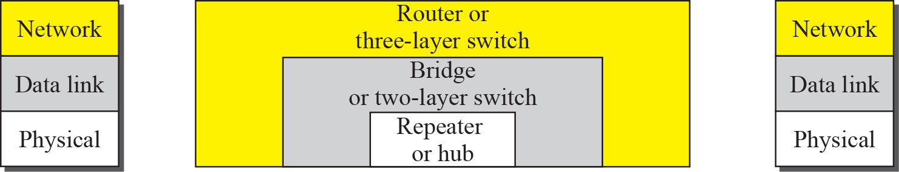
Figure 3.40 Connecting devices

Slide 29
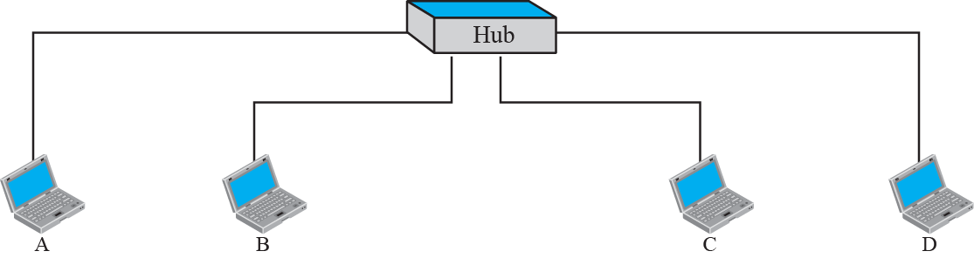
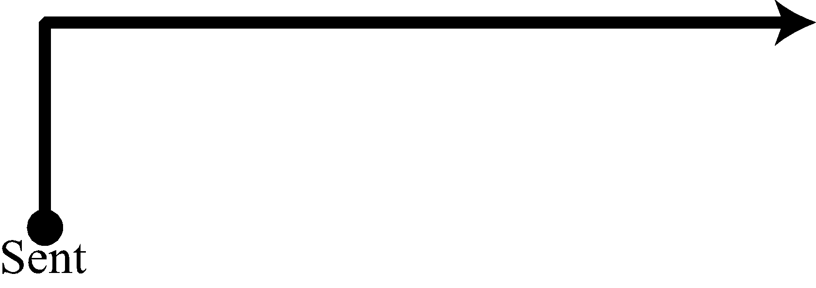
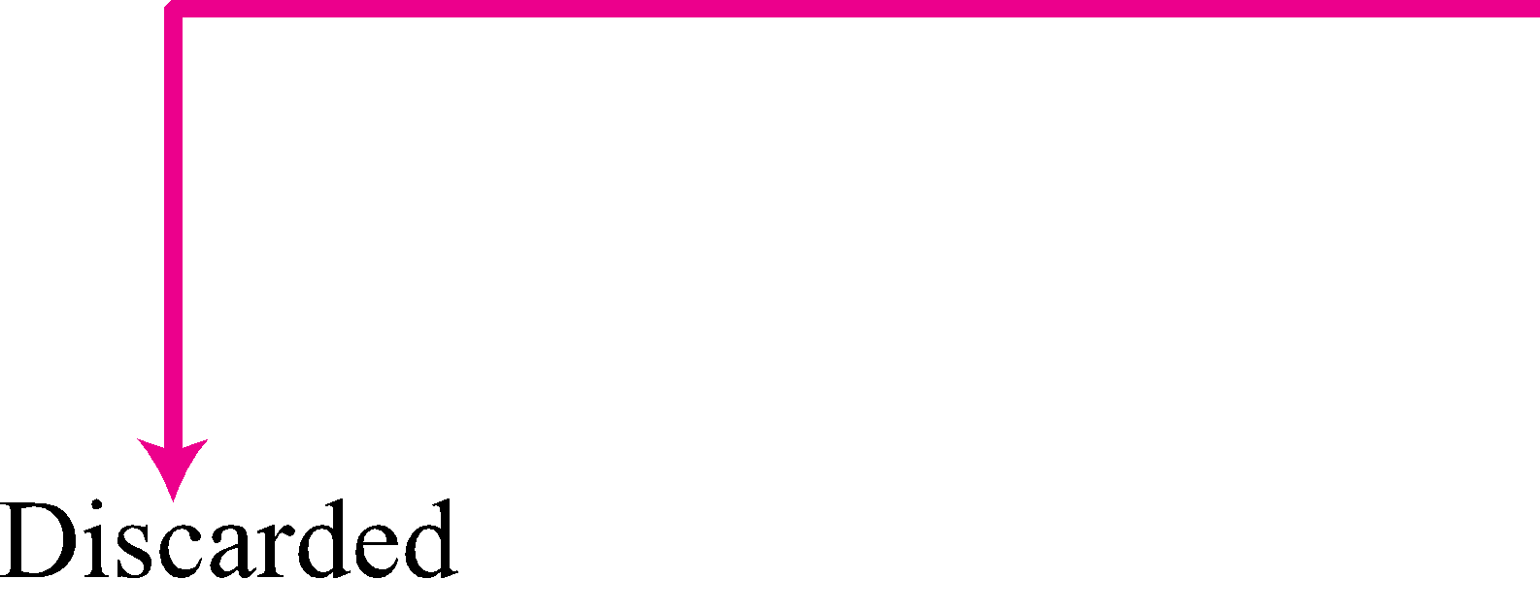
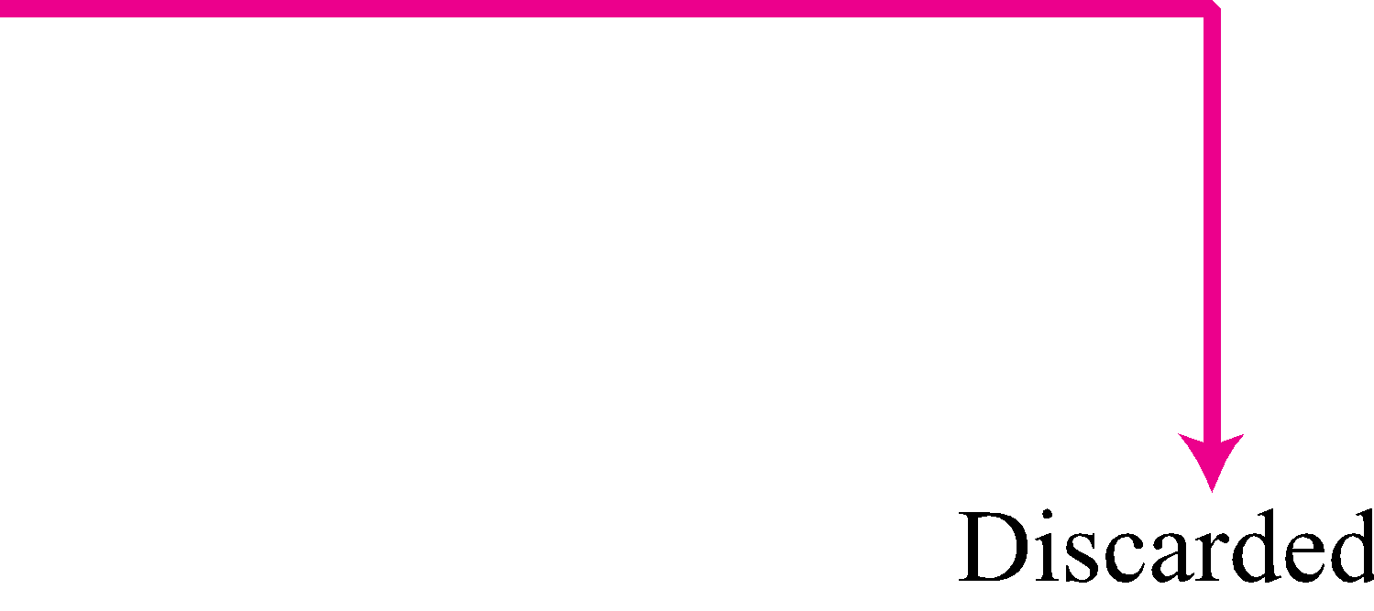
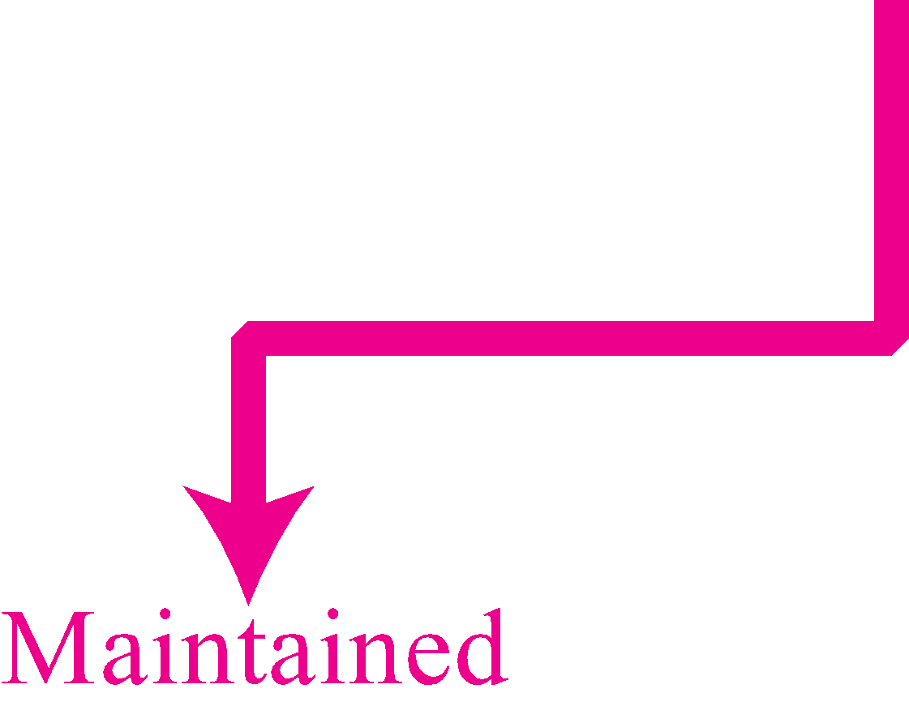
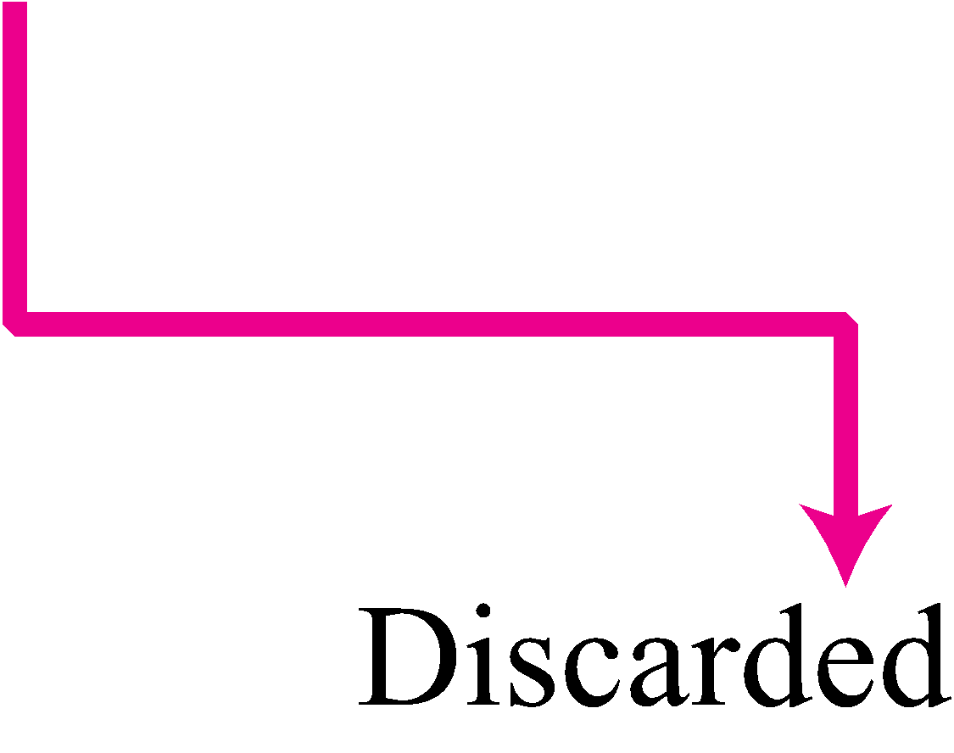
Figure 3.41 Repeater or hub
A repeater forwards every bit; it has no filtering capability.

Slide 30
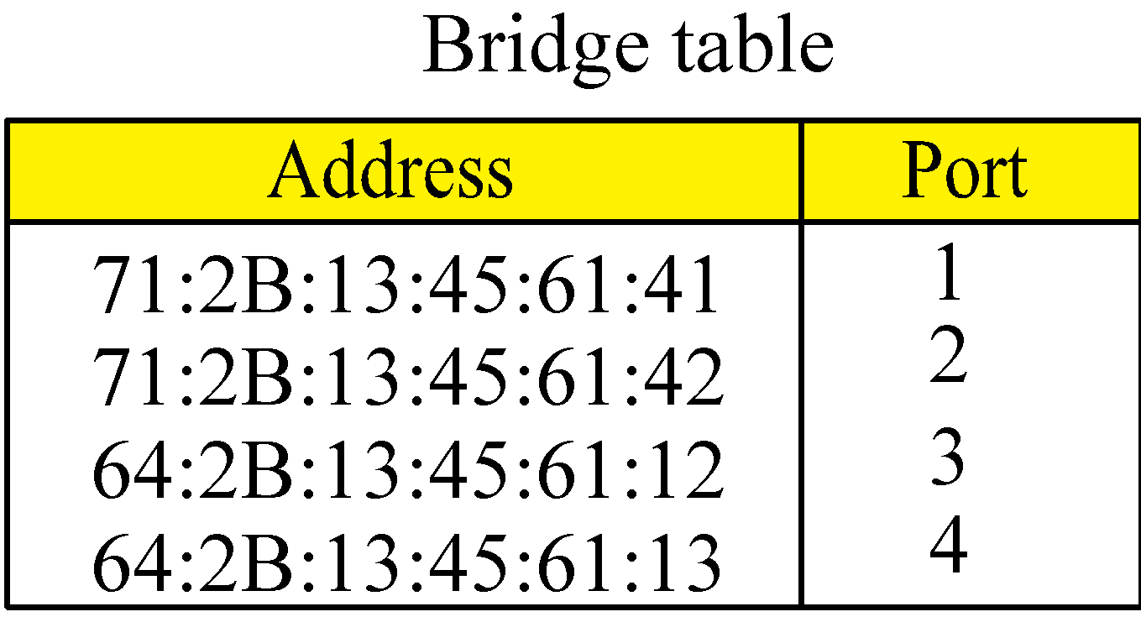
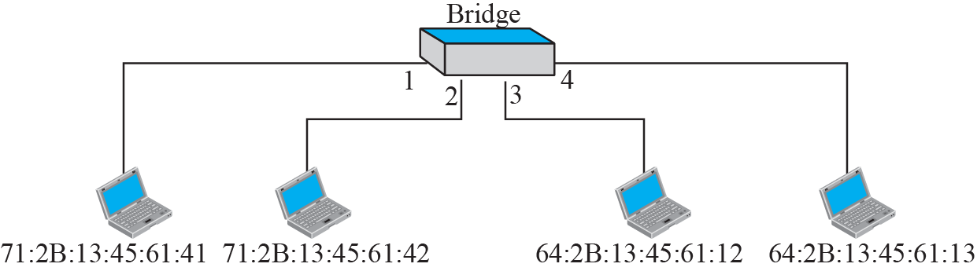
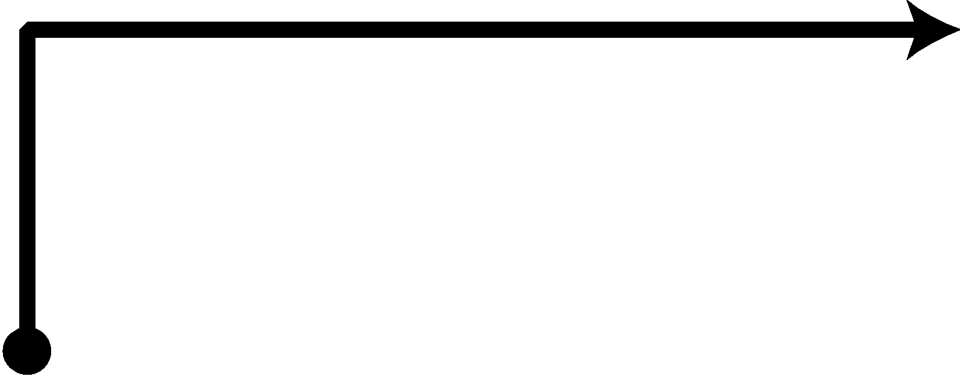

Figure 3.42 Bridge
A bridge does not change the physical (MAC) addresses in a frame.
A bridge has a table used in filtering decisions.

Slide 31
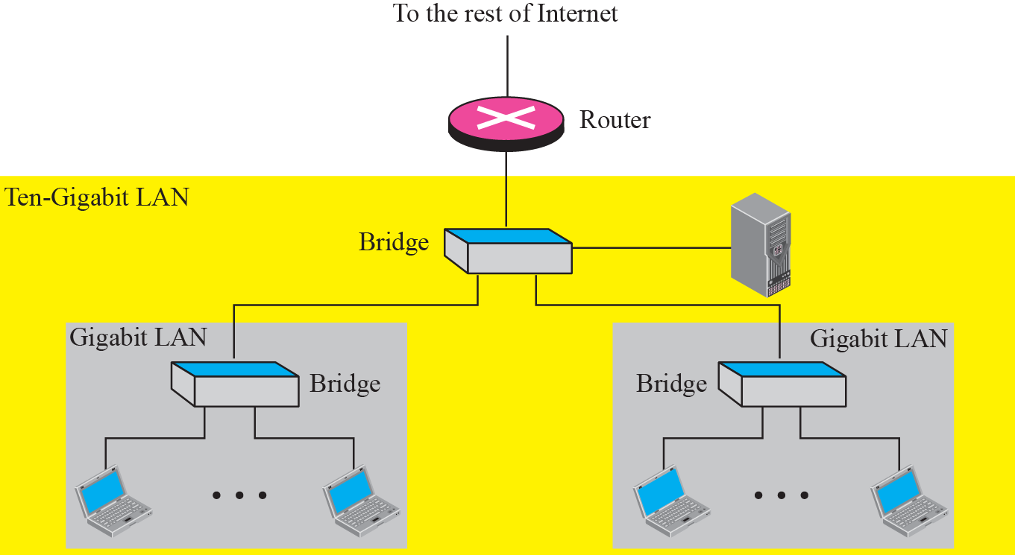
Figure 3.44 Routing example
A router is a three-layer (physical, data link, and network) device.
A repeater or a bridge connects segments of a LAN.
A router connects independent LANs or WANs to create an internetwork (internet).
A router changes the physical addresses in a packet.

Slide 32

Chapter 4
Introduction to
Network Layer
Copyright © The McGraw-Hill Companies, Inc. Permission required for reproduction or display.

Slide 33
4-1 INTRODUCTION
At the conceptual level, we can think of the global Internet as a black box network that connects millions (if not billions) of computers in the world together. At this level, we are only concerned that a message from the application layer in one computer reaches the application layer in another computer.

Slide 34
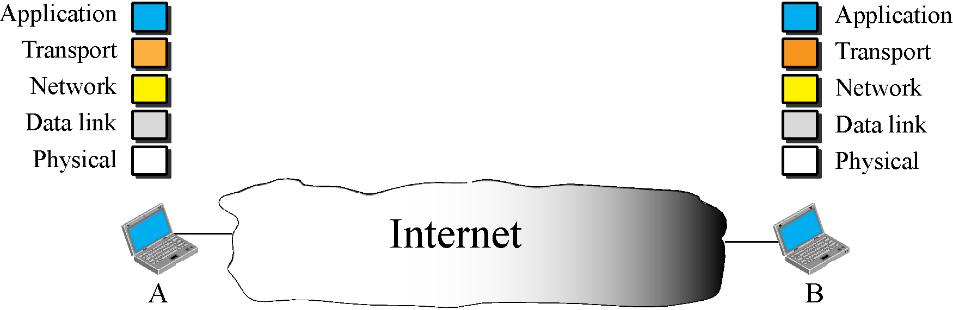
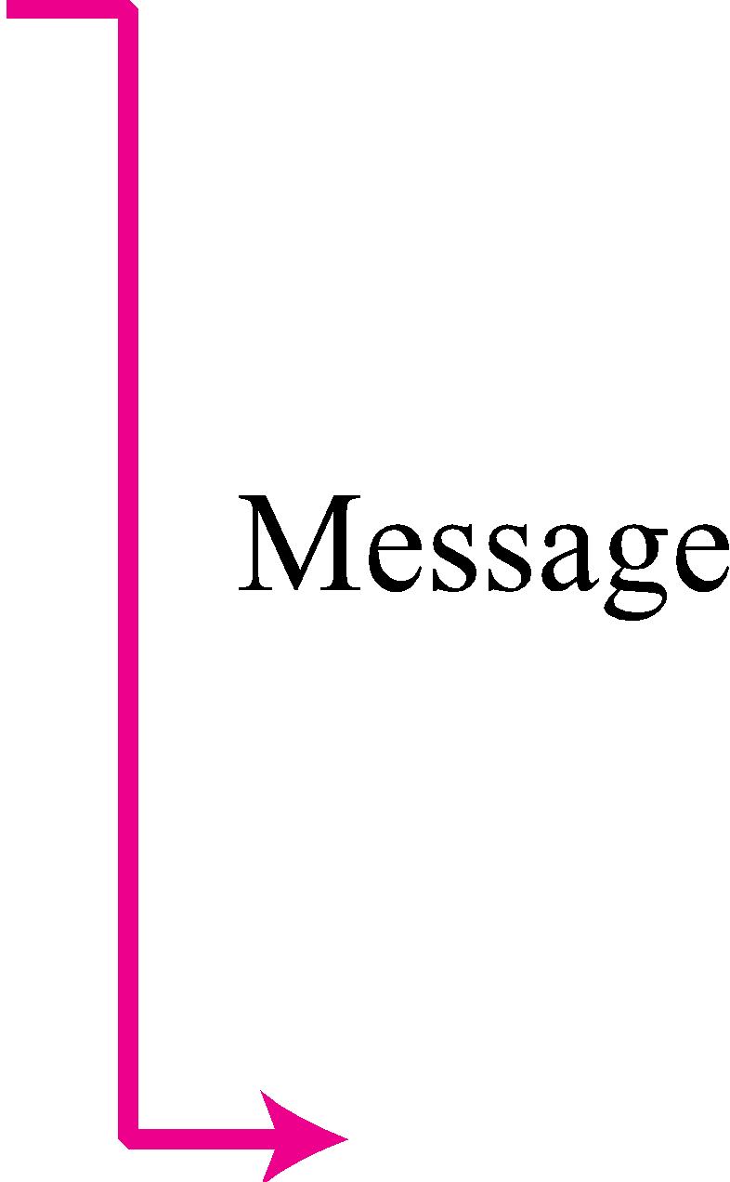
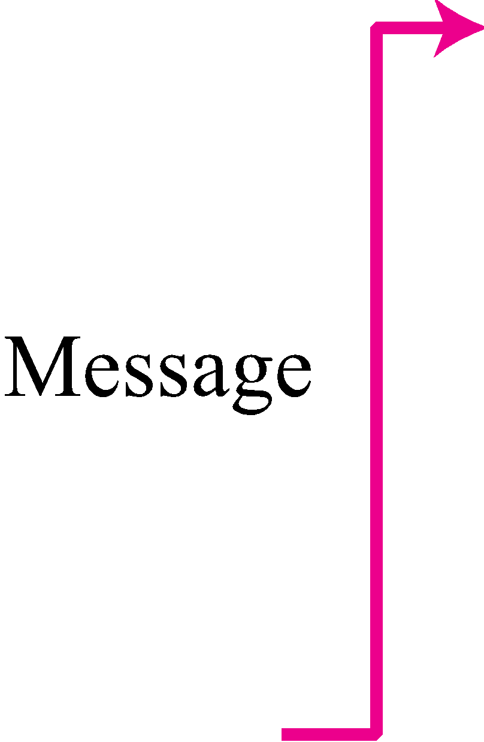
Figure 4.1 Internet as a block box

Slide 35
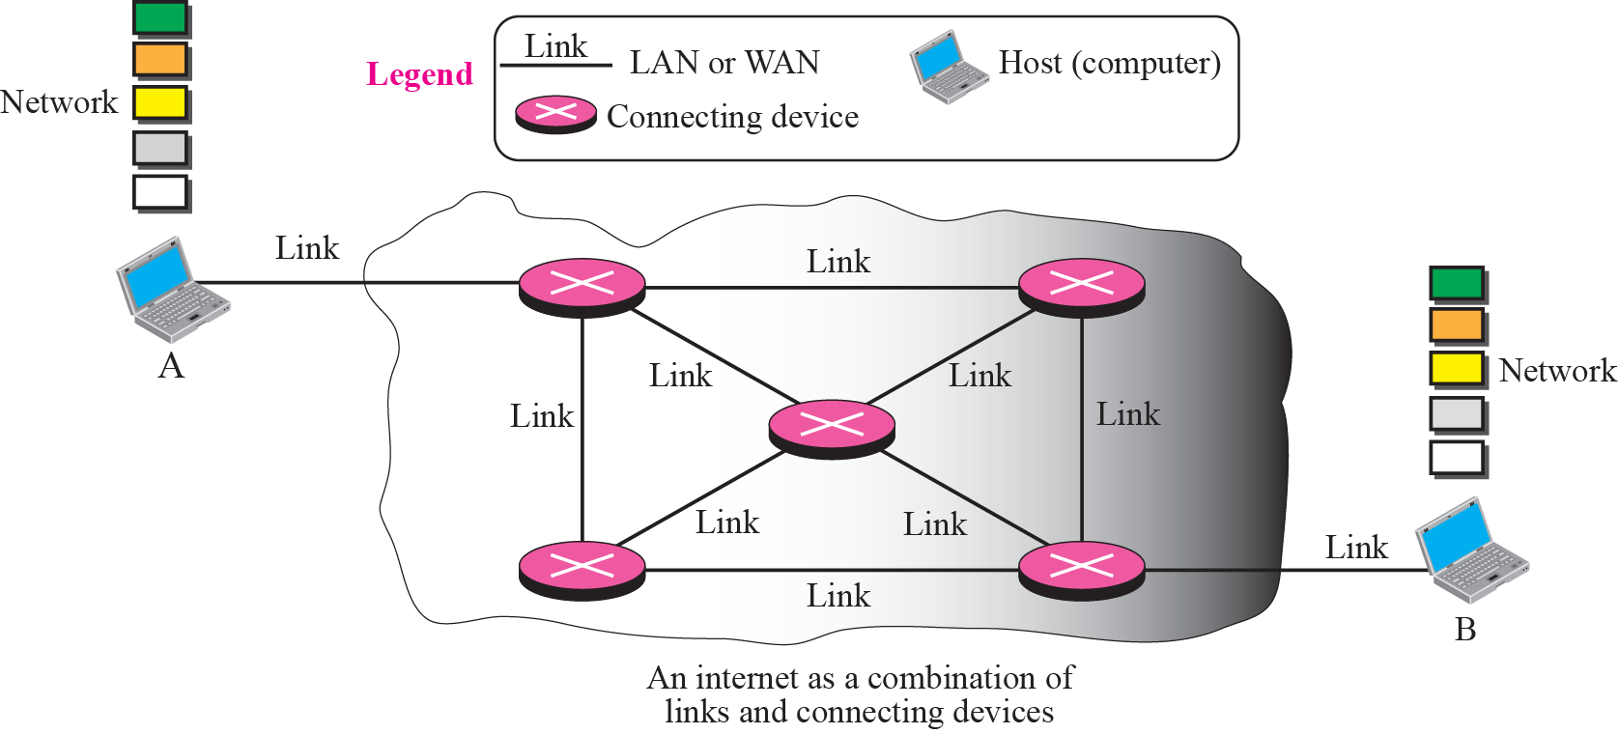
Figure 4.2 Internet as a combination of LANs and WANs connected together

Slide 36
4-2 SWITCHING
From the previous discussion, it is clear that the passage of a message from a source to a destination involves many decisions. When a message reaches a connecting device, a decision needs to be made to select one of the output ports through which the packet needs to be send out. In other words, the connecting device acts as a switch that connects one port to another port.

Slide 37
Circuit Switching
In circuit switching, the whole message is sent from the source to the destination without being divided into packets.
Packet Switching
In packet switching, the message is first divided into manageable packets at the source before being transmitted. The packets are assembled at the destination.

Slide 38
Example 4.1
A good example of a circuit-switched network is the early telephone systems in which the path was established between a caller and a callee when the telephone number of the callee was dialed by the caller. When the callee responded to the call, the circuit was established. The voice message could now flow between the two parties, in both directions, while all of the connecting devices maintained the circuit. When the caller or callee hung up, the circuit was disconnected. The telephone network is not totally a circuit-switched network today.

Slide 39
4-3 PACKET SWITHING
The network layer is designed as a packet-switched network. This means that the packet at the source is divided into manageable packets, normally called datagrams. Individual datagrams are then transferred from the source to the destination. The received datagrams are assembled at the destination before recreating the original message. The packet-switched network layer of the Internet was originally designed as a connectionless service, but recently there is a tendency to change this to a connection-oriented service.
Connectionless Service
Connection-Oriented Service

Slide 40
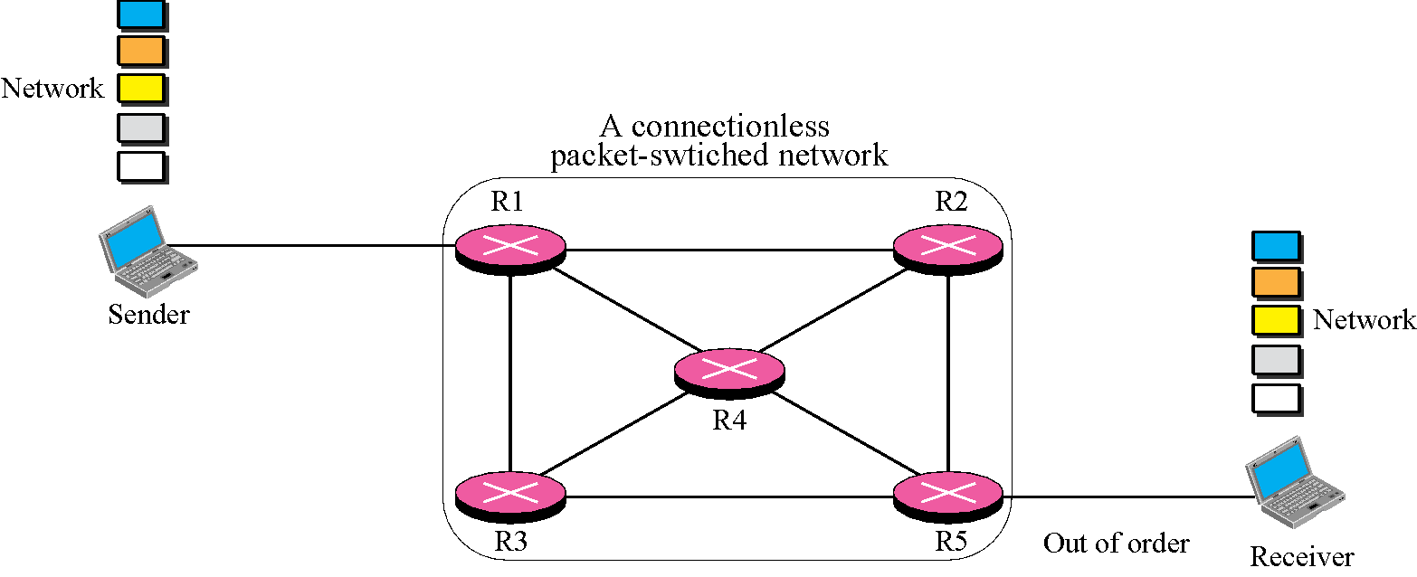
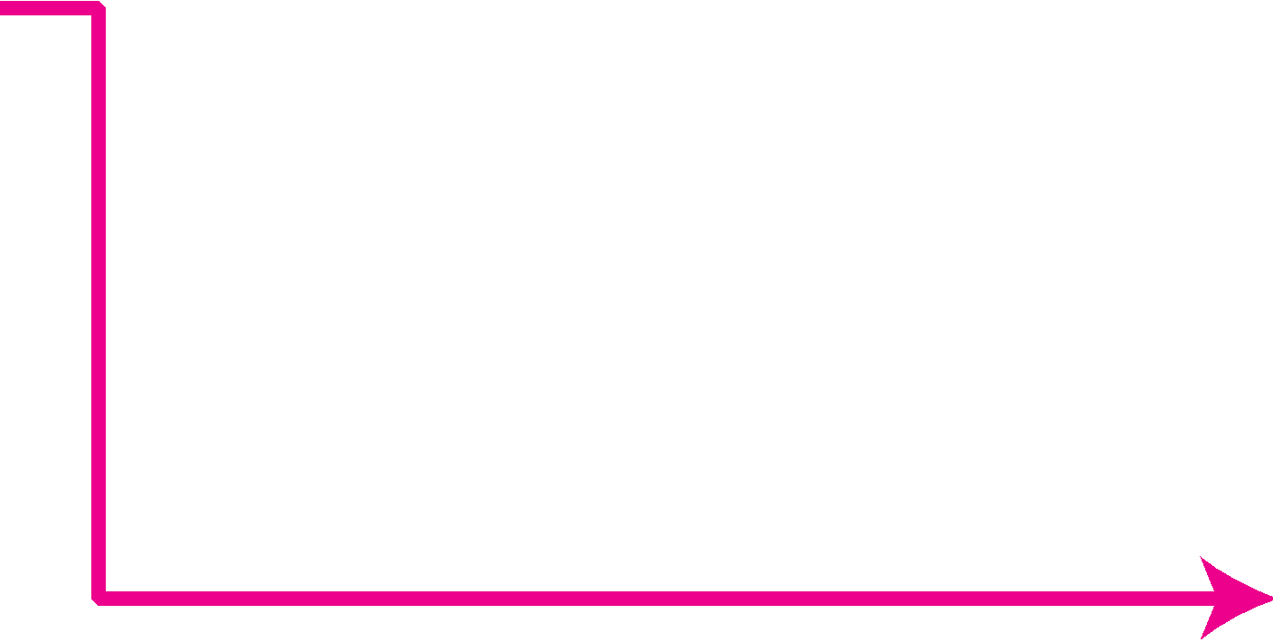

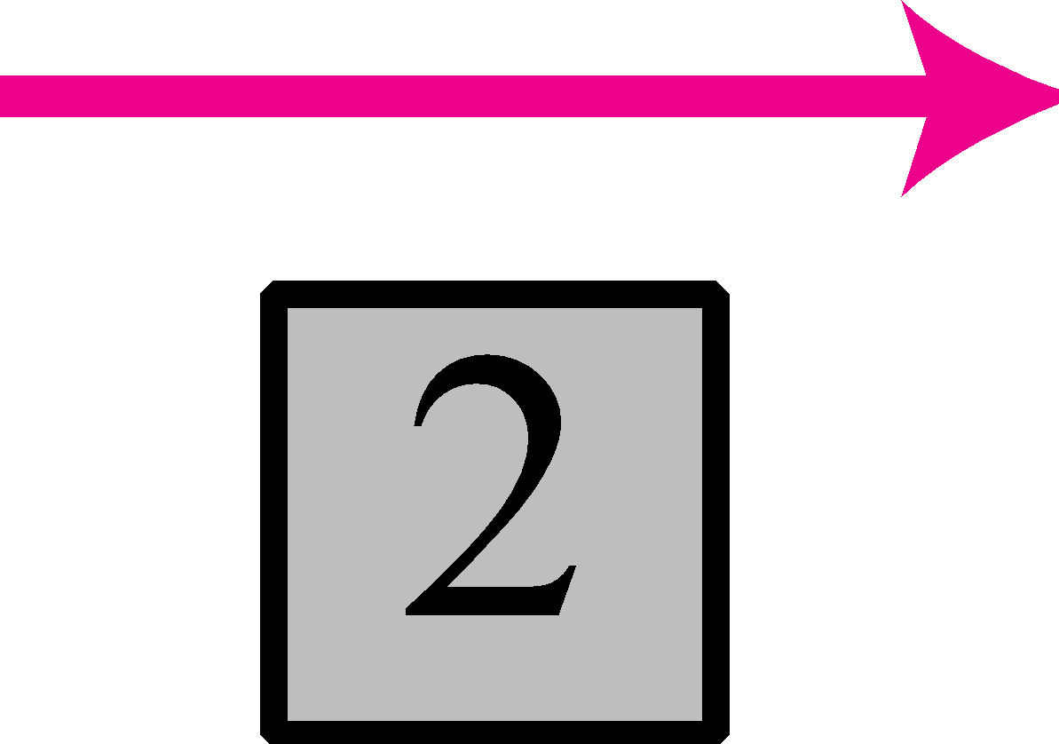
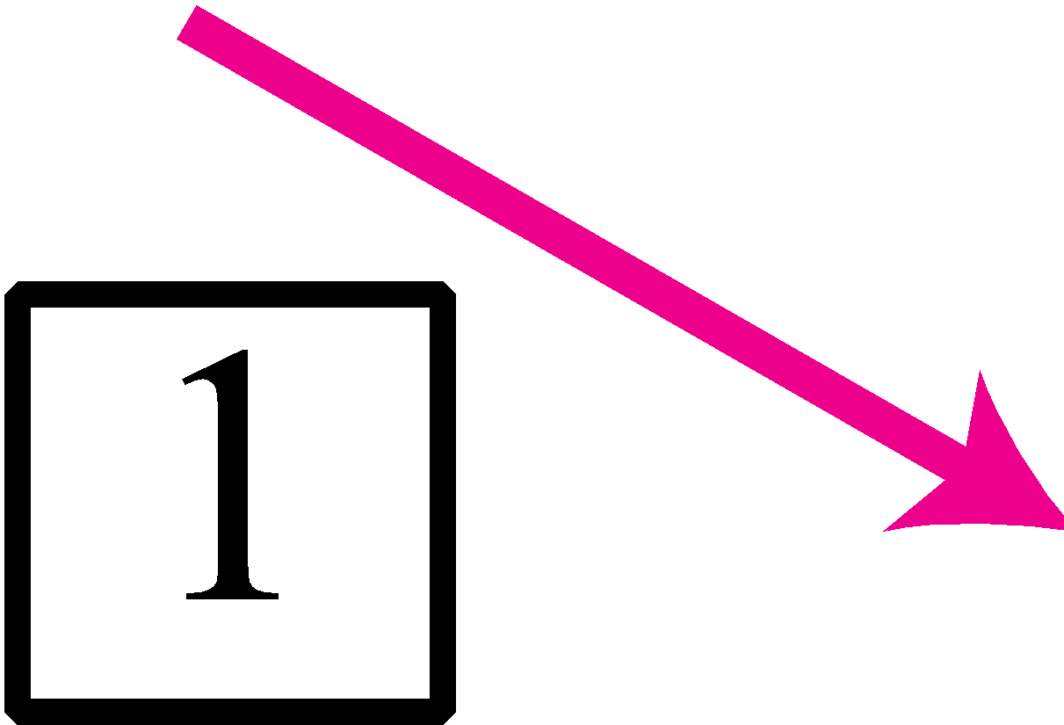
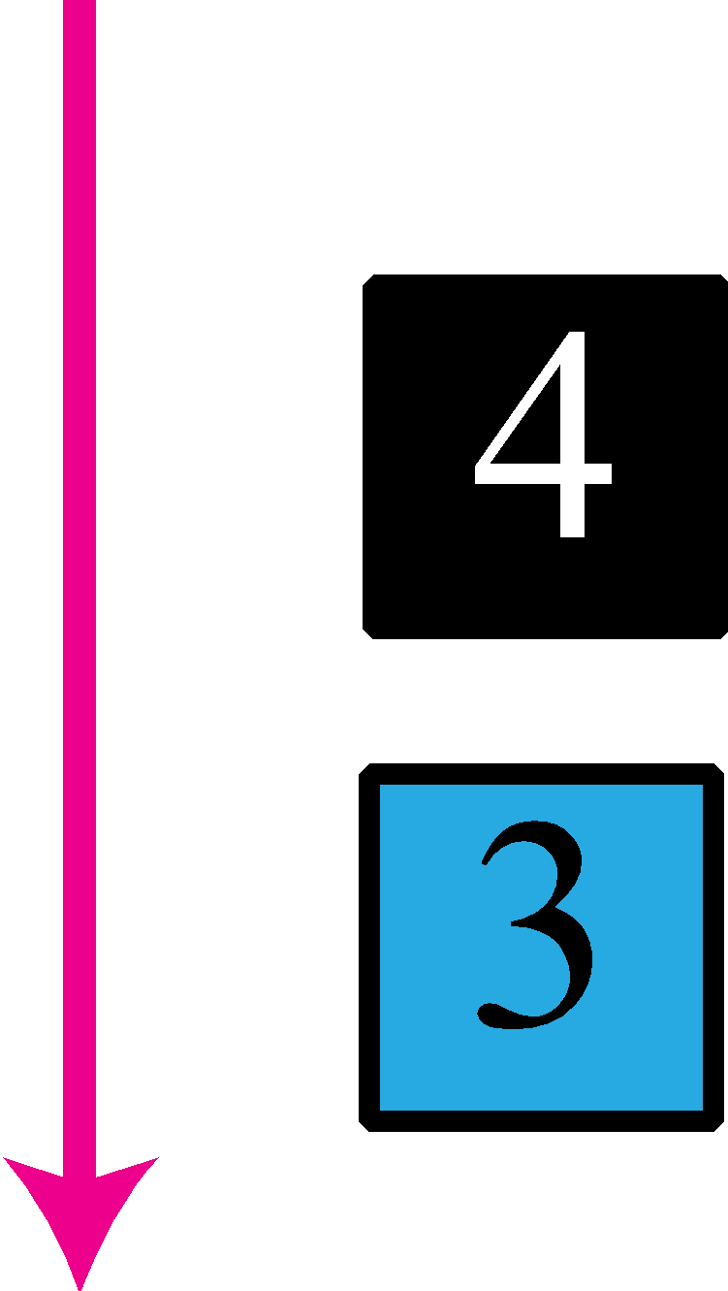
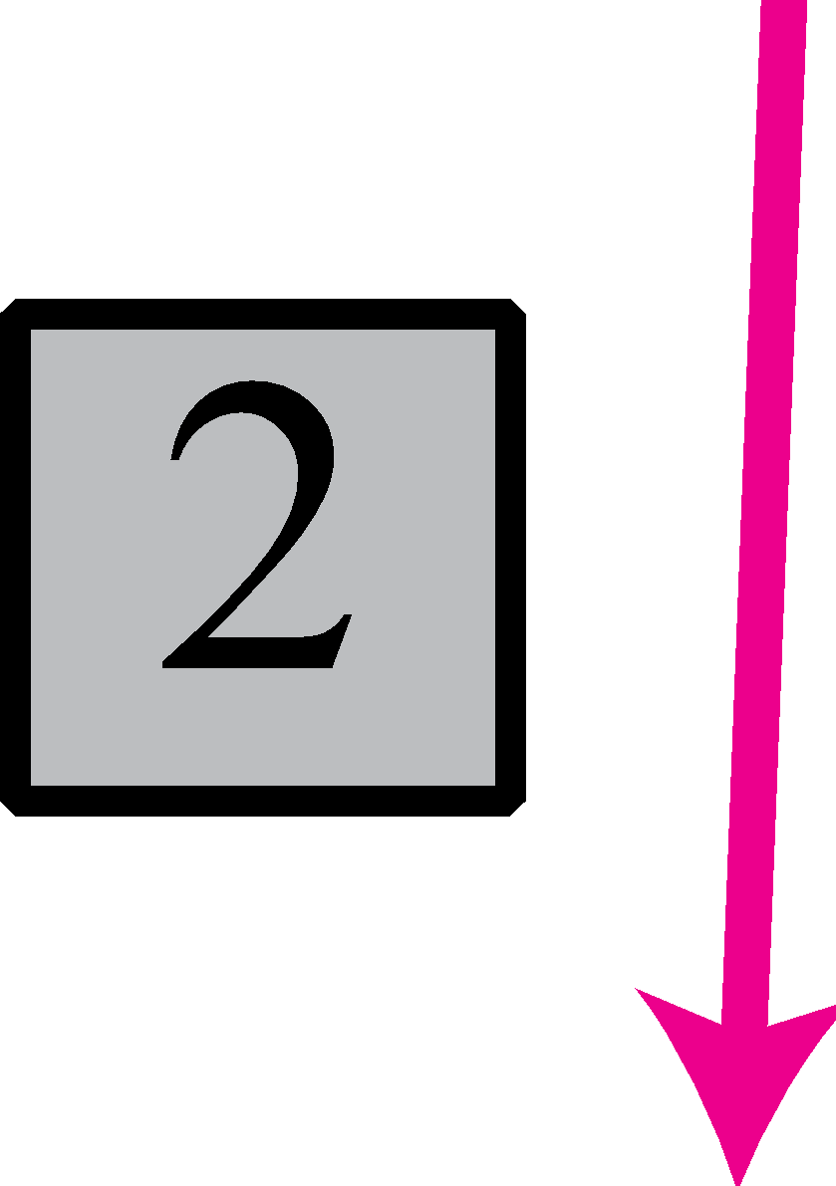

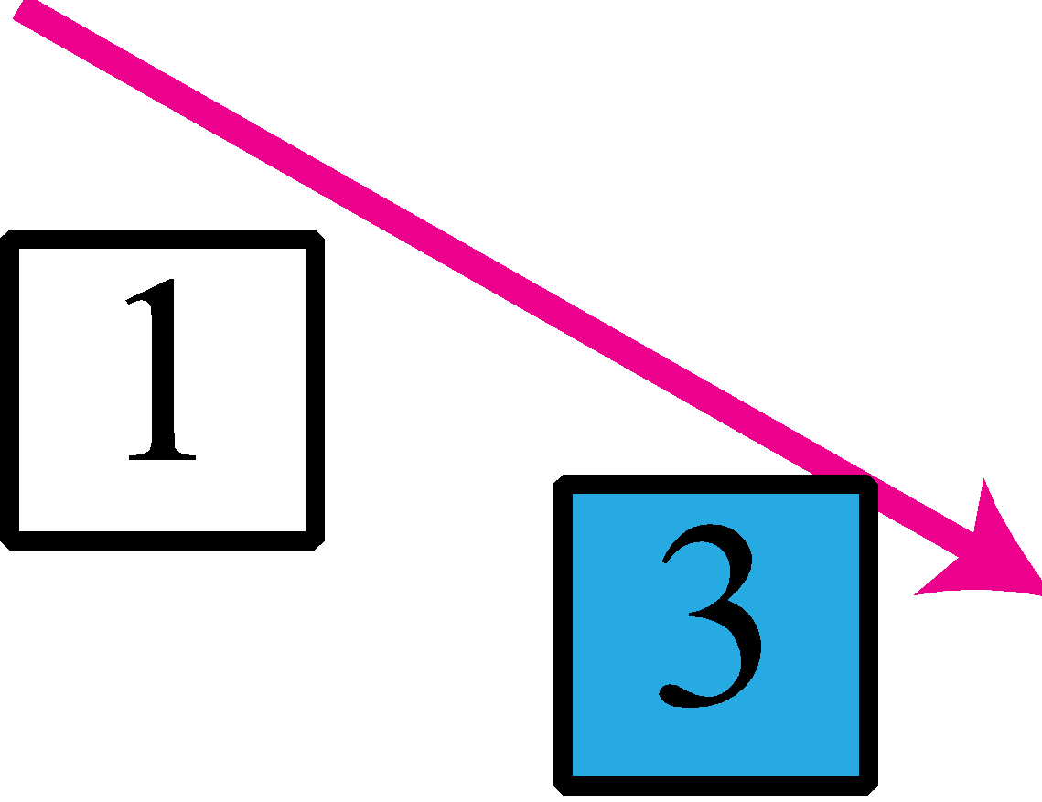
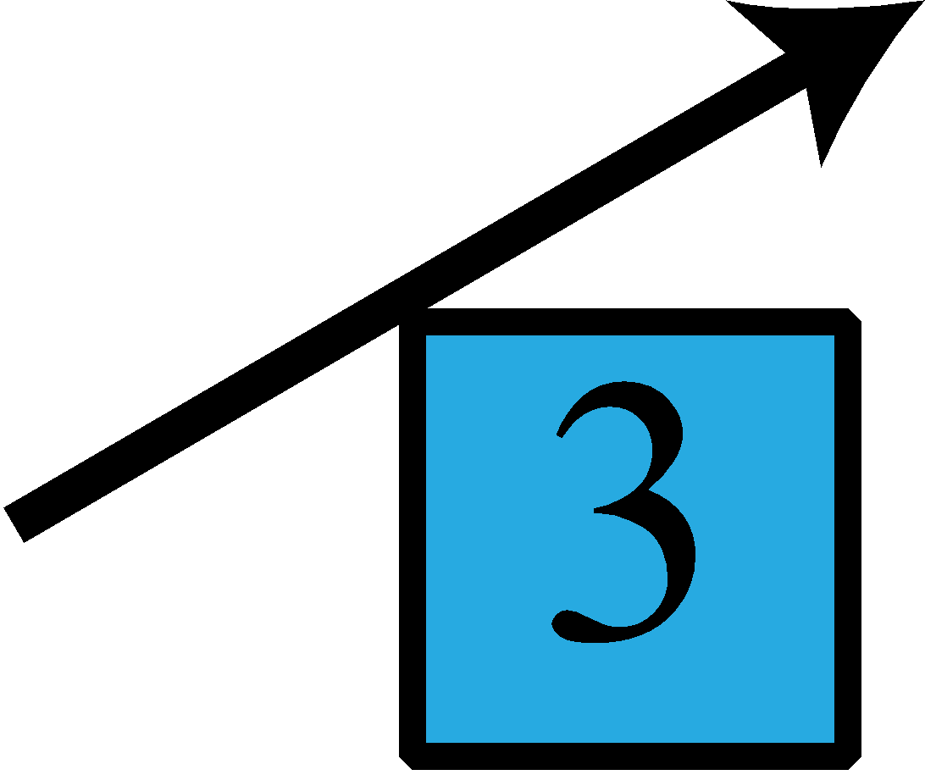
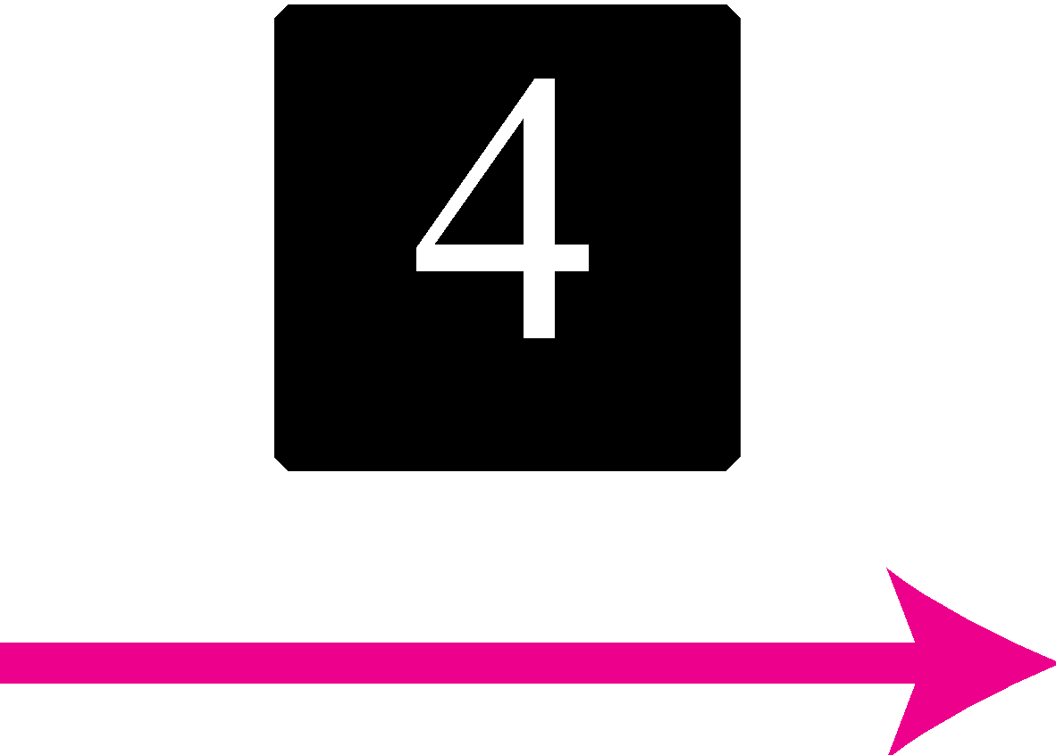

Figure 4.3 A connectionless packet-switched network
In a connectionless packet-switched network, the forwarding decision is based on the destination address of the packet.

Slide 41
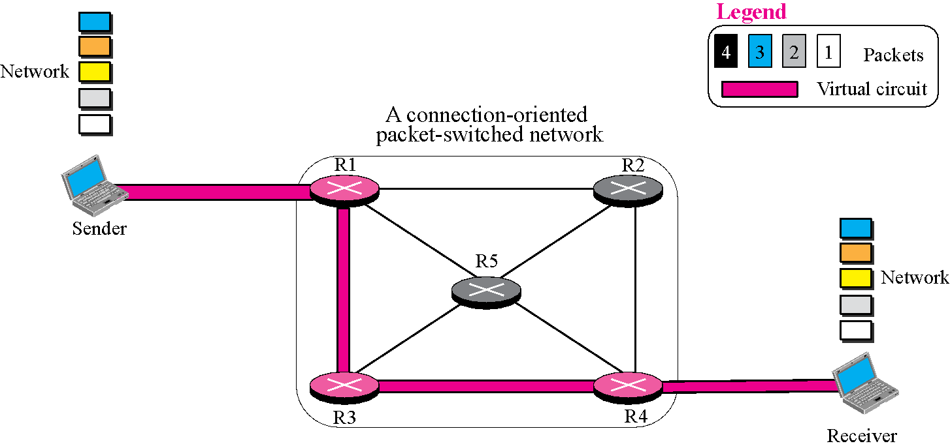
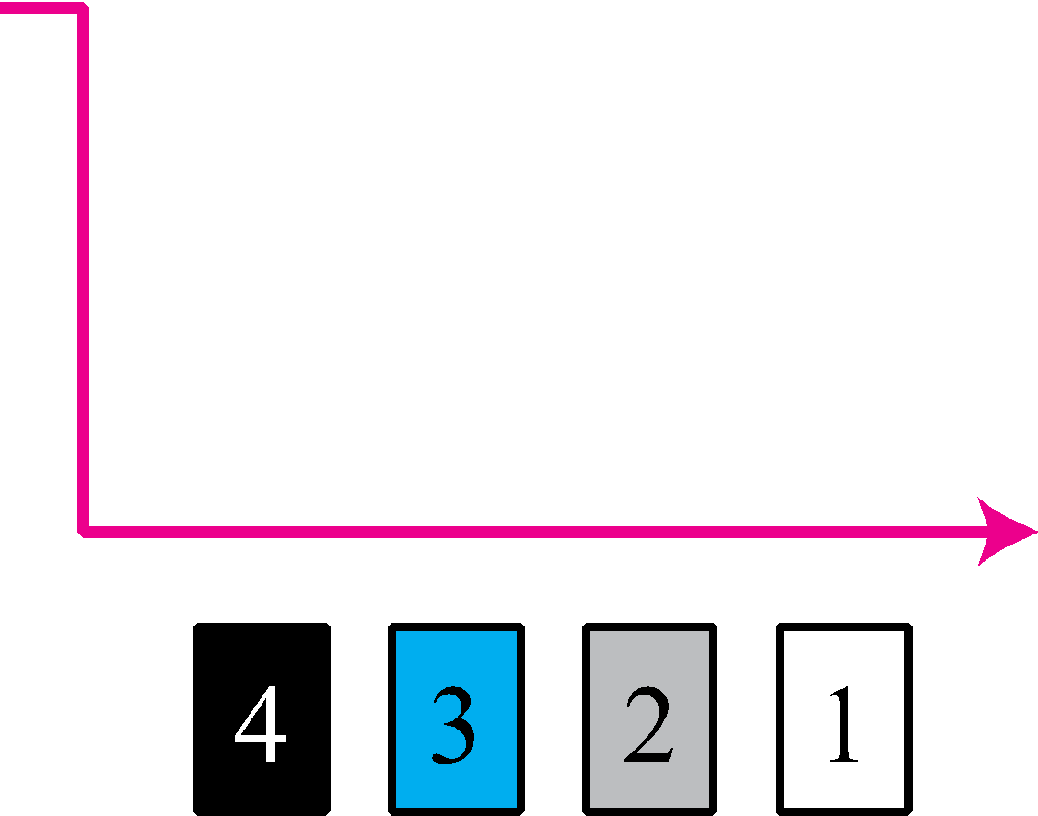
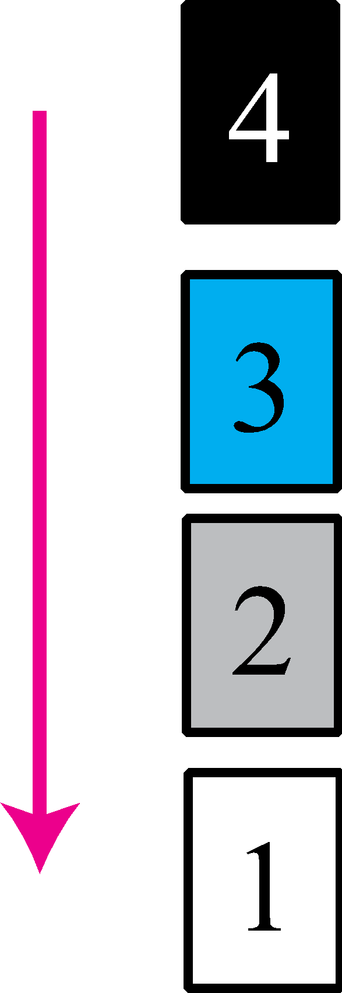

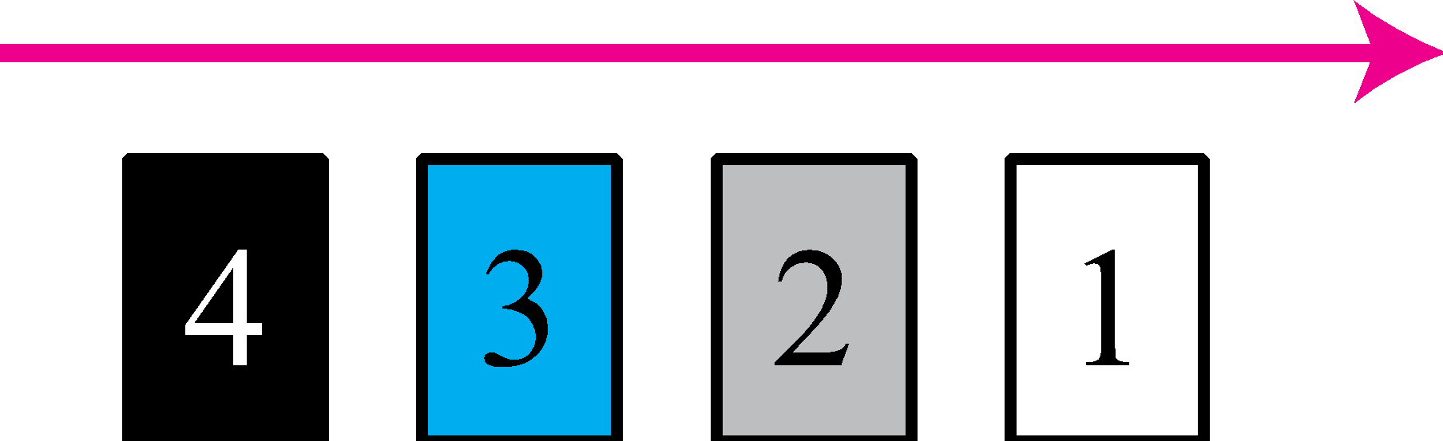

Figure 4.6 A connection-oriented packet switched network
In a connection-oriented packet switched network, the forwarding decision is based on the label of the packet.

Slide 42
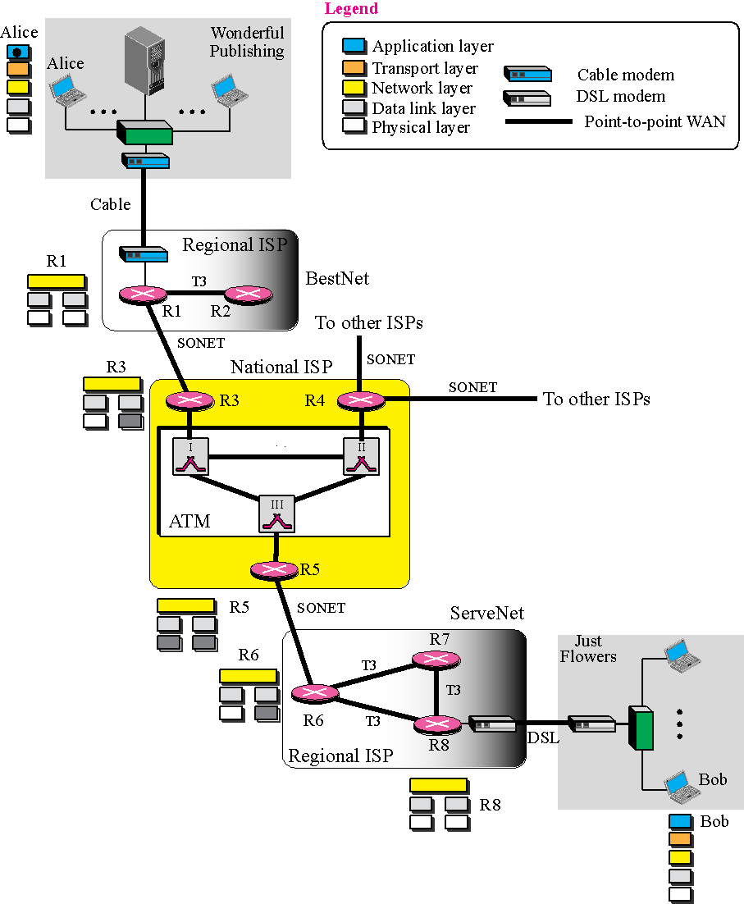
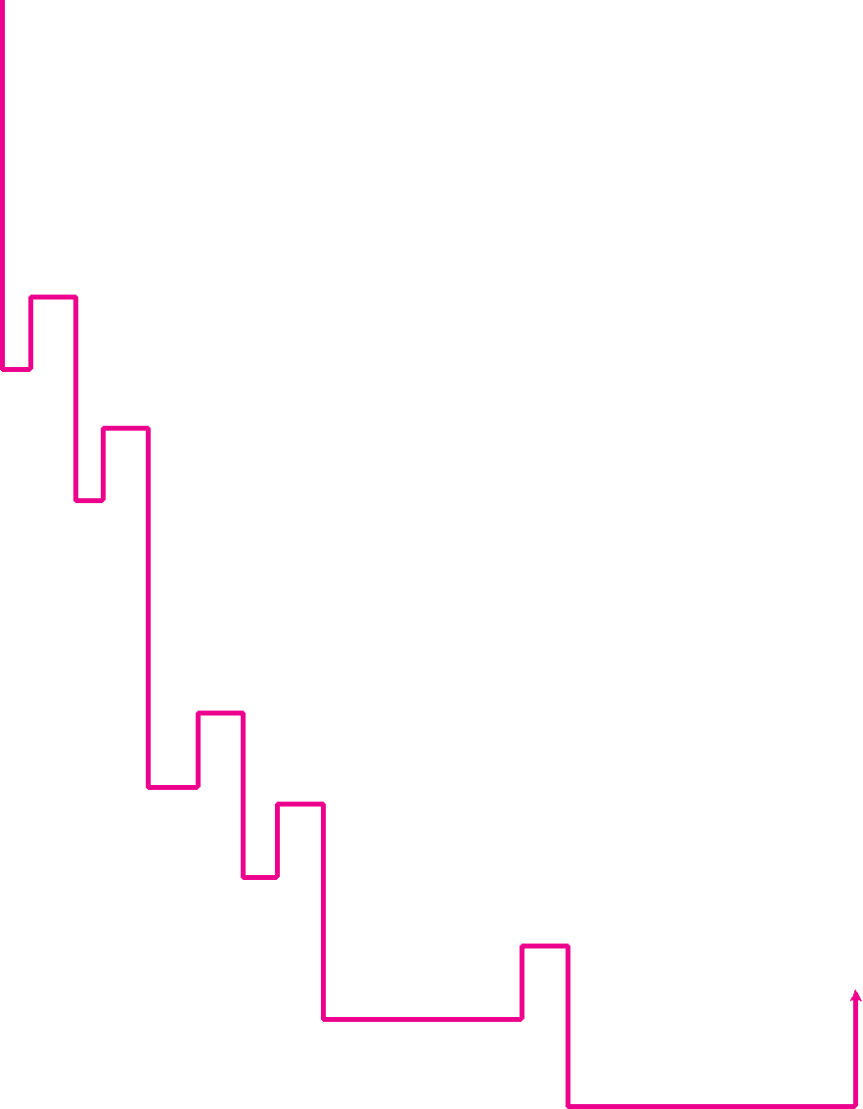
Figure 4.12 An imaginary part of the Internet

